Slide 1
Shaping the Linux kernel MPTCP implementation towards upstream acceptance
Doru-Cristian Gucea
Octavian Purdila

Slide 2

Agenda
MPTCP in a nutshell
Use-cases
Basics
Initial Linux kernel implementation
Implementation alternatives
Towards upstream submission
Questions

Slide 3
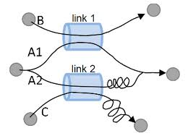
MPTCP in nutshell
Transport level multi-path solution
Unmodified applications and network
Works at least as well as regular TCP
Works when a regular TCP would work
Falls back to regular TCP if needed
Fair with TCP, moves traffic away from congestion

Slide 4
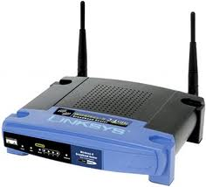

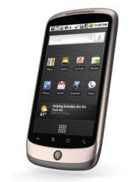


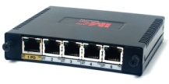
Improved mobility with MPTCP
Notes:
...
Power
Latecy – reinjecting traffic
Mention datacenter

Slide 5
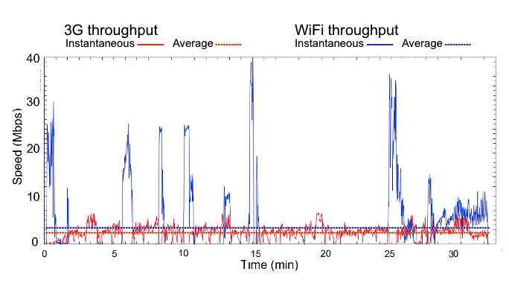
Throughput during a subway trip

Slide 6
Other MPTCP use-cases
Power improvements via race to idle
VM migration across different network domains
Multi-WiFi: take advantage of multiple APs
Improved throughput and reliability in the data-center

Slide 7

MPTCP basics
3G celltower

Slide 8
MPTCP basics
3G celltower
SYN
MP_CAPABLE X

Slide 9
MPTCP basics
3G celltower
SYN/ACK MP_CAPABLE Y

Slide 10
MPTCP basics
3G celltower
ACK MP_CAPABLE

Slide 11
MPTCP basics
3G celltower
STATE
CWND
Snd.SEQNO
Rcv.SEQNO
…

Slide 12
MPTCP basics
3G celltower
STATE
CWND
Snd.SEQNO
Rcv.SEQNO
…
SYN
JOIN Y

Slide 13
MPTCP basics
3G celltower
STATE
CWND
Snd.SEQNO
Rcv.SEQNO
…
SYN
JOIN Y

Slide 14
MPTCP basics
3G celltower
STATE
CWND
Snd.SEQNO
Rcv.SEQNO
…
SYN/ACK
JOIN X

Slide 15
MPTCP basics
3G celltower
STATE
CWND
Snd.SEQNO
Rcv.SEQNO
…
STATE B
CWND
Snd.SEQNO
Rcv.SEQNO
…

Slide 16
MPTCP basics
3G celltower
STATE
CWND
Snd.SEQNO
Rcv.SEQNO
…
DATA
SEQ A DSEQ: 1
STATE B
CWND
Snd.SEQNO
Rcv.SEQNO
…

Slide 17
MPTCP basics
3G celltower
STATE
CWND
Snd.SEQNO
Rcv.SEQNO
…
DATA
SEQ A DSEQ: 1
STATE B
CWND
Snd.SEQNO
Rcv.SEQNO
…
DATA
SEQ B
DSEQ: 2

Slide 18
Initial Linux kernel implementation
Implementation done directly at the TCP level
Good performance
Low overhead when falling back to TCP
Intrusive changes that increases the complexity of the TCP stack

Slide 19
Key MPTCP structures
TCP socket, visible to userspace
Meta socket
Master socket
Sub-flow socket
Sub-flow socket
TCP sockets, not visible to userspace

Slide 20
Pros/cons of using TCP sockets
Re-use TCP code that transfers data to/from userspace (tcp_sendmsg, tcp_recvmsg)
Makes MPTCP transparent to the application (including fallback)
Some TCP functions now must deal with 3 cases
  TCP socket
  MPTCP sub-flow socket
  MPTCP meta socket

Slide 21
Creating the master socket
Meta socket
Meta socket
SYN,MP
mptcp_sk_clone
SYN,ACK,MP
ACK,MP
Master socket

Slide 22
Fallback to TCP
Meta socket
SYN,MP
mpc =false
SYN,ACK
ACK
Plain TCP socket

Slide 23
TCP queues (simplification)
tcp_recvmsg
tcp_sendmsg
Receive q
Write q
tcp_retransmit_skb
tcp_write_xmit
out of order q
tcp_transmit_skb
Backlog q
tcp_v4_rcv

Slide 24
MPTCP receive path
mptcp_sk_ready
tcp_recvmsg
Sub-flow receive q
Meta receive q
mptcp_backlog_rcv
Sub-flow out of order q
Meta backlog q
Meta out of order q
tcp_v4_rcv
mptcp_sk_ready

Slide 25
MPTCP send path
tcp_sendmsg
Meta write q
mptcp_retransmit_skb
mptcp_write_xmit
Mptcp scheduler
Sub-flow write q

Slide 26
MPTCP DSS options
Head
Reservered for
MAC/IP/TCP header
Maps meta seq to sub-flow seq
20 bytes
Does not fit into skb->cb
Save them in the skb data in the space reserved for the TCP header
Everytime pskb_copy() is called from the TCP stack we need to copy DSS manually
Save
DSS
here
Data
Tail
End

Slide 27
Alternative approaches
Userspace implementation
  Requires infrastructure to pass / receive MPTCP options from userspace
    Use control messages for sendmsg/recvmsg
    Needs new userspace ABIs to handle the connection handshake
  Complete rewrite
Create a separate layer on top of TCP (similar with how NFS, CIFS uses TCP)

Slide 28
Towards a separate MPTCP layer
Eliminate the branches in the TCP code that deals with MPTCP sub-flow and meta sockets
  Isolate the MPTCP sub-flow functionality
  MPTCP meta sockets are not TCP sockets – create a new protocol to deal with them
Eliminate code duplication between TCP and MPTCP

Slide 29
MPTCP sub-flow specific code in TCP
MPTCP connection hand-shake
  Client side
  Server side
MPTCP receive window
MPTCP send and receive path hooks
MPTCP coupled congestion code

Slide 30
Isolate MPTCP connection handshake – TX
Connect socket operations
Connection socket operations are used to abstract and isolate IPv4 and IPv6
By defining MPTCP specific connection socket operation we isolated the TX part of MPTCP sub-flow handshake
queue_xmit
send_check
con_request
syn_recv_sock
...

Slide 31
Isolate MPTCP connection handshake – RX
Request socket operations
On the receive side request socket operations are used to abstract MD5 code
Unfortunately these operations are not enough to isolate MPTCP code but...
We noticed significant code duplication between the IPv4 and IPv6 paths
md5_lookup
calc_md5_hash

Slide 32
Isolate MPTCP connection handshake – RX
Request socket operations
Added new operations to abstract and isolate the IPv4 and IPv6 paths
With that we also isolated the RX part of MPTCP sub-flow handshake
init_req
cookie_init_seq
cookie_init_seq
route_req
send_synack
queue_hash_add
init_seq

Slide 33
Isolate MPTCP receive window and send path
TCP socket operations
Introduce a new structure to abstract some TCP socket operations
Specific operations for the meta socket, sub-flow socket and regular TCP
write_xmit
write_wakeup
select_initial_window
init_buffer_space
set_rto
...

Slide 34
git diff v3.18..mptcp_trunk --stat (>10)
include/linux/tcp.h | 85 +-
include/net/sock.h | 11 +
include/net/tcp.h | 194 ++-
net/core/sock.c | 35 +-
net/ipv4/af_inet.c | 27 +-
net/ipv4/inet_connection_sock.c | 21 +-
net/ipv4/tcp.c | 182 ++-
net/ipv4/tcp_fastopen.c | 28 +-
net/ipv4/tcp_input.c | 320 +++-
net/ipv4/tcp_ipv4.c | 202 ++-
net/ipv4/tcp_minisocks.c | 95 +-
net/ipv4/tcp_output.c | 254 ++--
net/ipv4/tcp_timer.c | 81 +-
net/ipv6/tcp_ipv6.c | 274 +++-

Slide 35
Separate MPTCP meta layer
Rationale: the meta socket is not a TCP socket
Create a new IP protocol level socket for MPTCP
socket(AF_INET, SOCK_STREAM, IPROTO_TCP|TCPEXT_MPTCP)

Slide 36
WIP: early allocation of the master socket
Allocate the master socket as soon as the meta socket is created
Falling back to TCP adds overhead as we now go through the meta socket
MPTCP is not transparent at the application level*
Simplifies the connect path:
  Connect of meta socket translates to connect on master socket
  Avoids cloning the meta socket and changes in the inet connection layer

Slide 37
WIP: receive path
sk_data_ready (on sub-flow sockets)
scan the rx queue update DSS mapping
mark sub-flow and wake-up meta socket
tcp_recvmsg
mptcp_recvmsg (on meta socket)
wait_event(wq, ready_sub-flows)
for all ready sub-flows
lock sock(sub-flow)
tcp_read_sock(sub-flow) – recv actor
clone SKB and add to meta socket
clear sub-flow ready bit
release_sock(sub-flow)
tcp_recvmsg (meta socket, O_NONBLOCK)
Meta receive q
Meta out of order q
mptcp_recvmsg
Sub-flow receive q

Slide 38
WIP: send path
mptcp_sendmsg
Meta write q
tcp_send_skb?
MPTCP Reinjection
work queue
Sub-flow write q
tcp_push

Slide 39
Conclusions
MPTCP has interesting use-cases and it is used commercially
The initial Linux kernel implementation had large TCP stack changes
We have been steadily reducing changes to the TCP stack
We believe a separate MPTCP layer should help us reduce TCP changes even more and help us manage the complexity

Slide 40
Thank you!

